Slide 1




+
Assignment
Balloon Pop

Slide 2
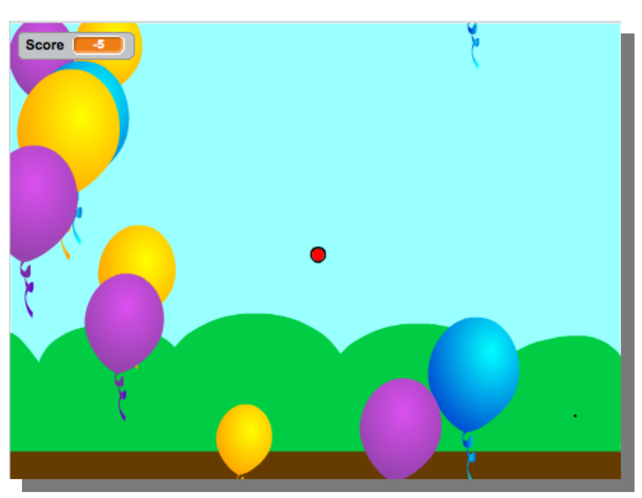
Balloon Pop
The goal of 'Balloon Pop' is to pop the blue balloons.
Popping a blue balloon will give you 1 point, popping another color will result in 2 penalty points.
The red marker will pop the balloons and is moved by your hand with the leap motion.
To start making this game open 'BalloonPop.sb2'.

Slide 3
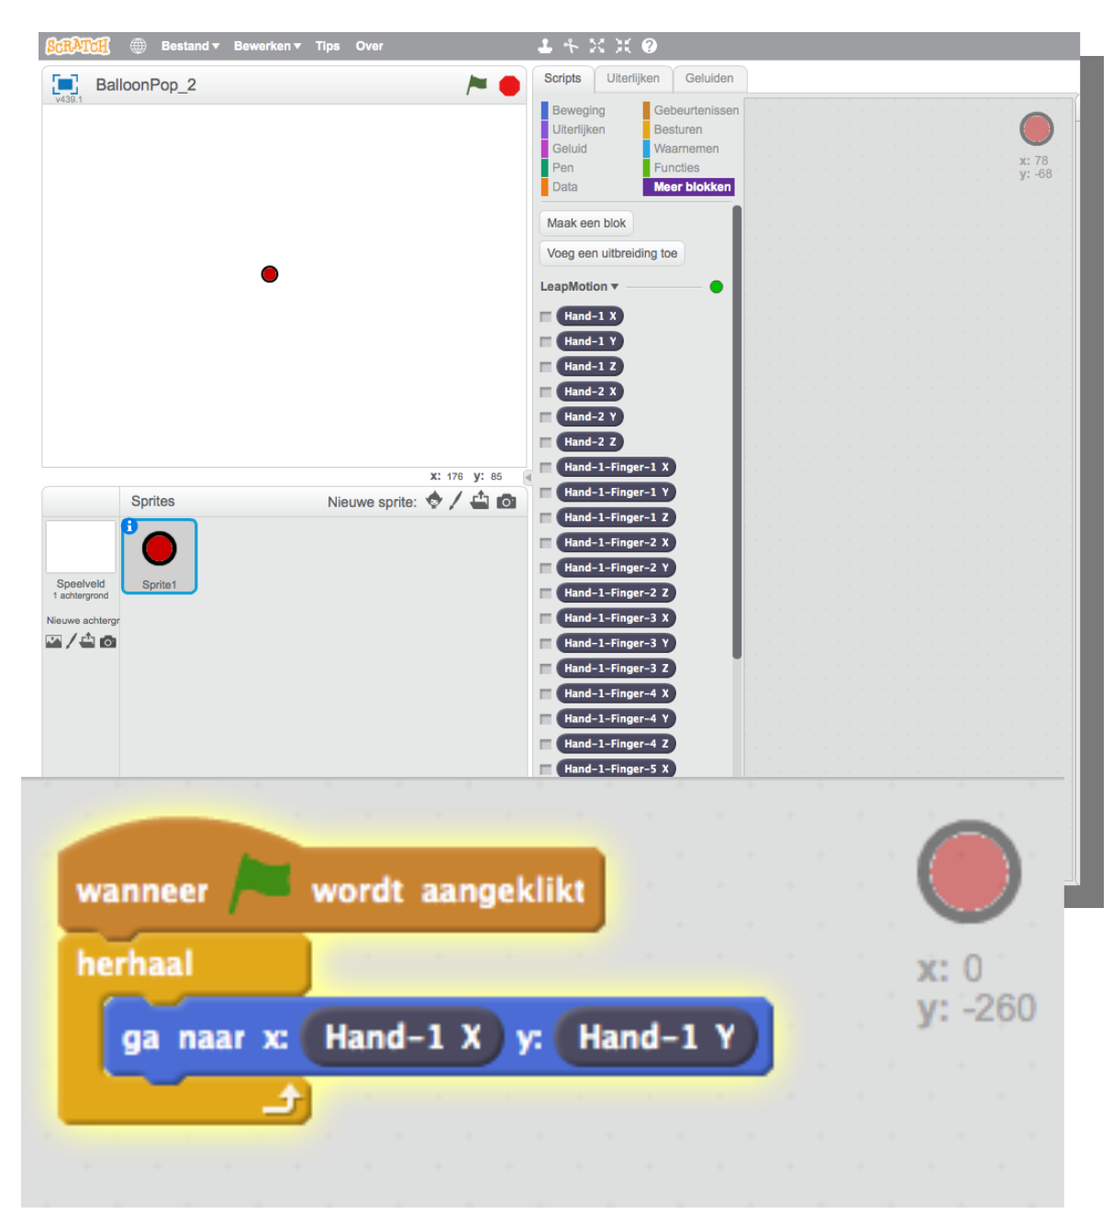
Balloon Pop
We're going to move a sprite on the screen with the leap motion.
Choose a sprite or make one your self. We are going to use the sprite to pop the balloons.
In the screenshot on the right you see a red dot we created our self.
Let the sprite move with the leap motion when you start the program (click the green flag).
Balloon Pop
<number>

Slide 4
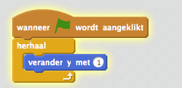
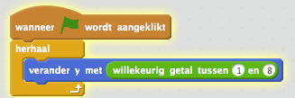

Balloon Pop
Add a balloon sprite.
Let the balloon move up when the program is started.
Try to make the speed the balloon rises a bit more random.
When the balloon is at the top of the screen the balloon should disappear. Try to change the start position of the balloon at the bottom of the screen.
Balloon Pop
<number>

Slide 5
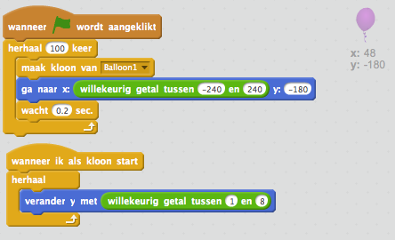
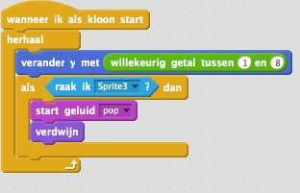
Balloon Pop
We need more balloons!
With the following change 100 balloons will start.
When the red dot hits the balloon, the balloon should disappear and make a 'pop' sound.
Balloon Pop
<number>

Slide 6
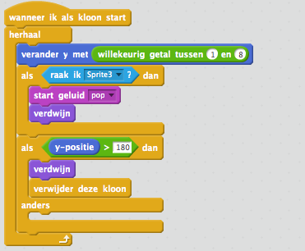
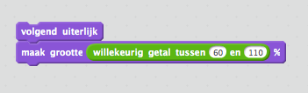
Balloon Pop
The balloons that arrive at the top of the screen and didn't pop should disappear
With the following code the size and color is random
Balloon Pop
<number>

Slide 7
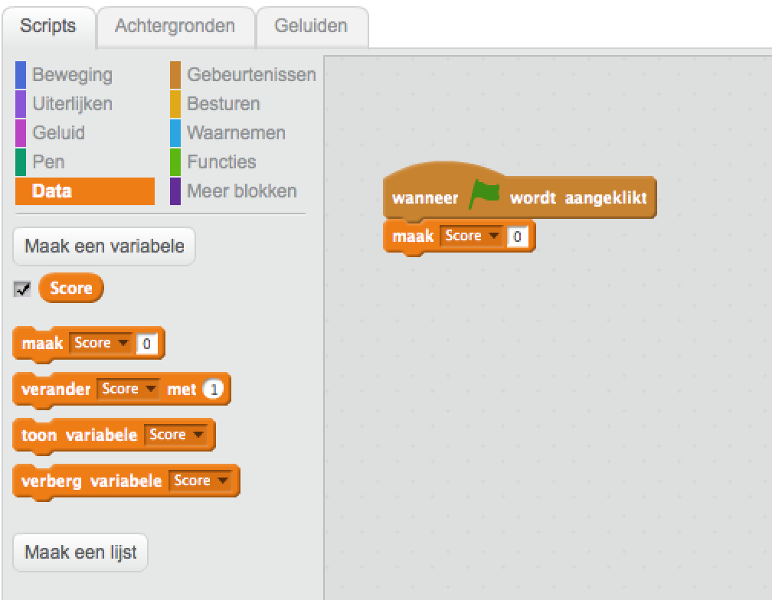



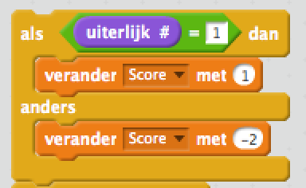
Balloon Pop
Counting points!
Make a data element with the name 'score'.
The score will be visible on the screen, with the following code the score will start at 0
1 Point
-2 Points
The Balloon pop game is almost ready!
Lets implement counting the points
Balloon Pop
<number>

Slide 8
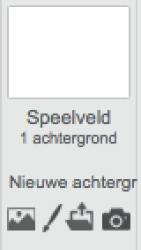
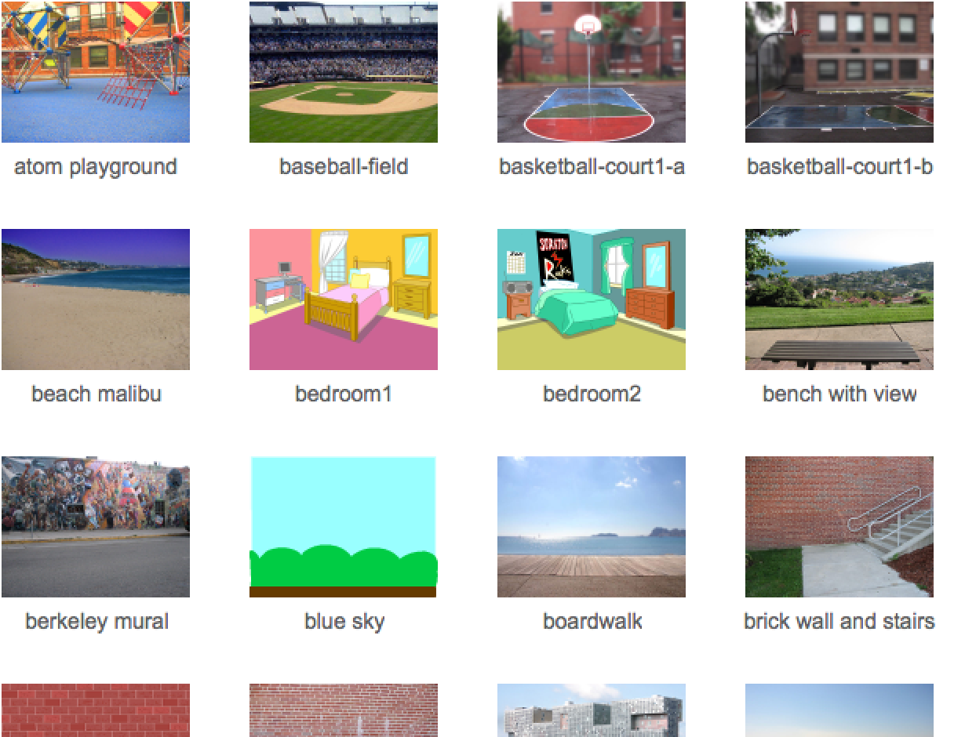

Balloon Pop
Lets set a nice background
There is enough choice
Finished?
What things do you like to add to
make the game more fun or more difficult.
Think about things like:
Smaller balloons
Speed
Sideways movement of the balloons.
Balloon Pop
<number>

